Slide 1
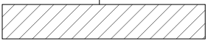
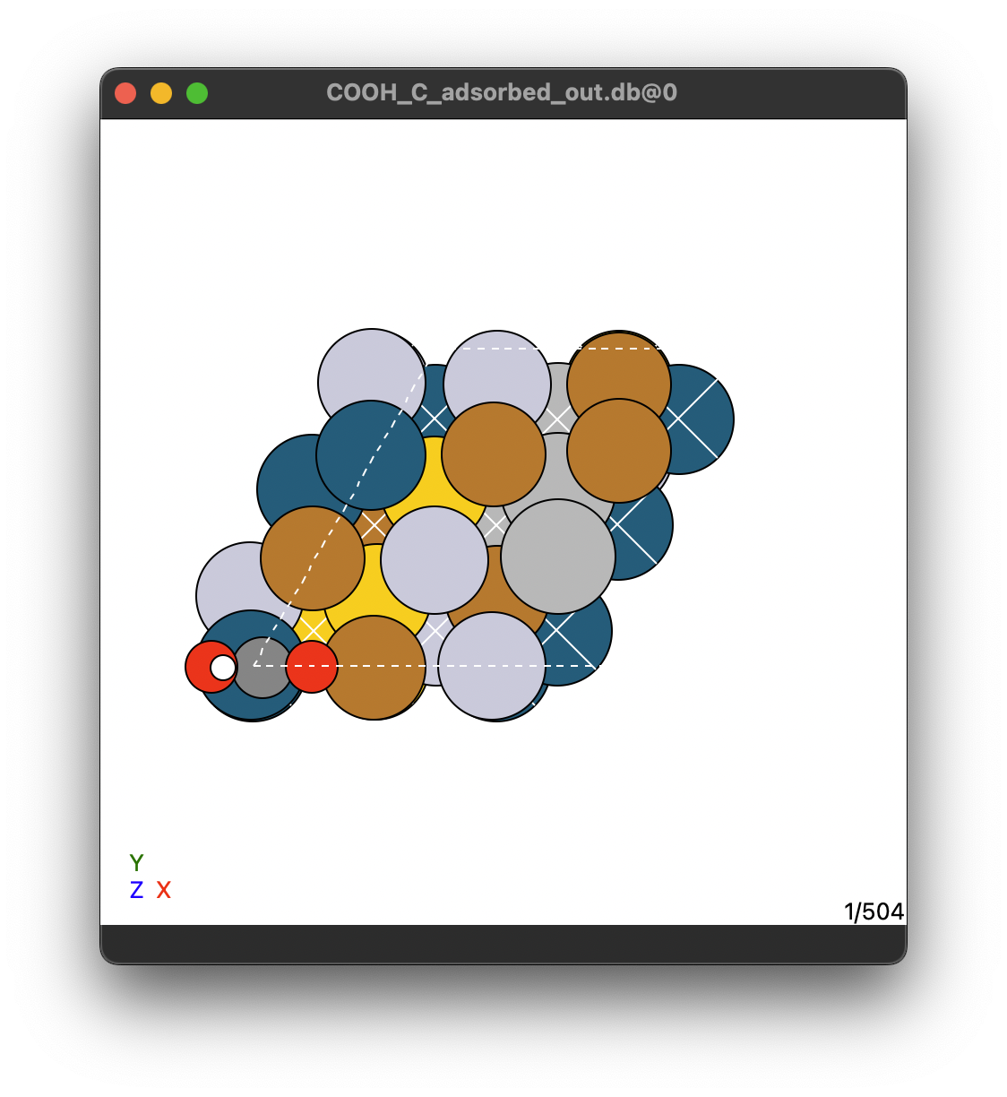
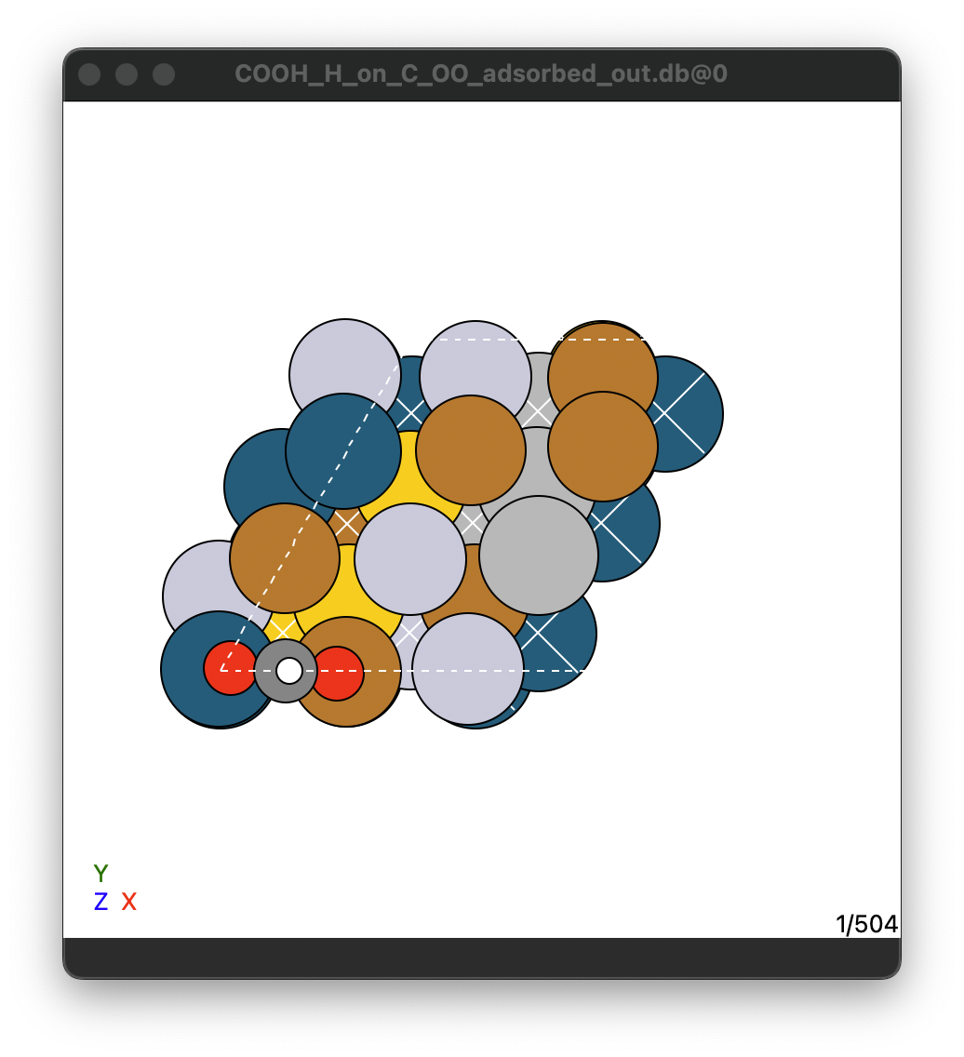

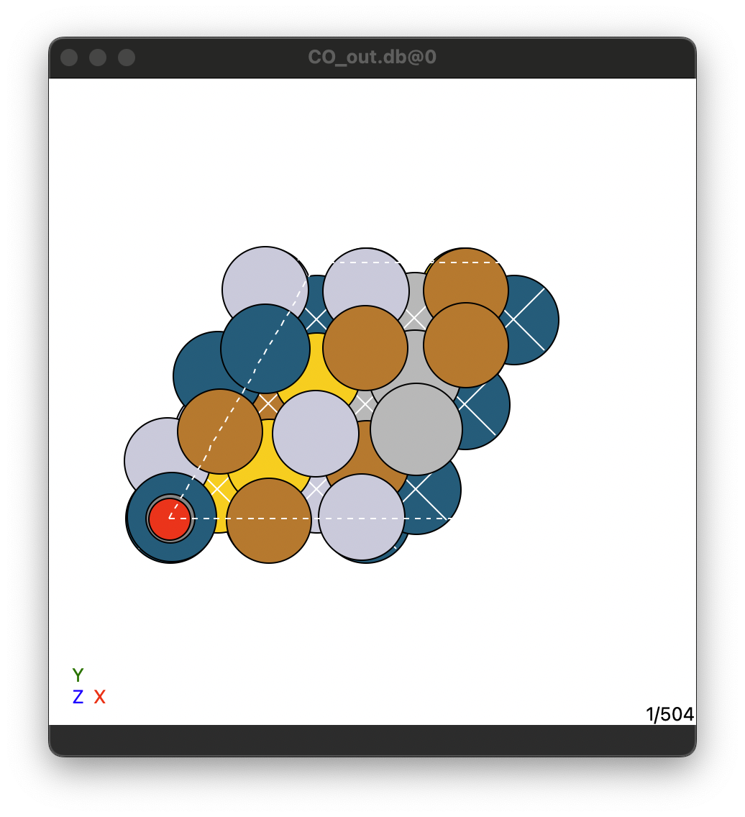
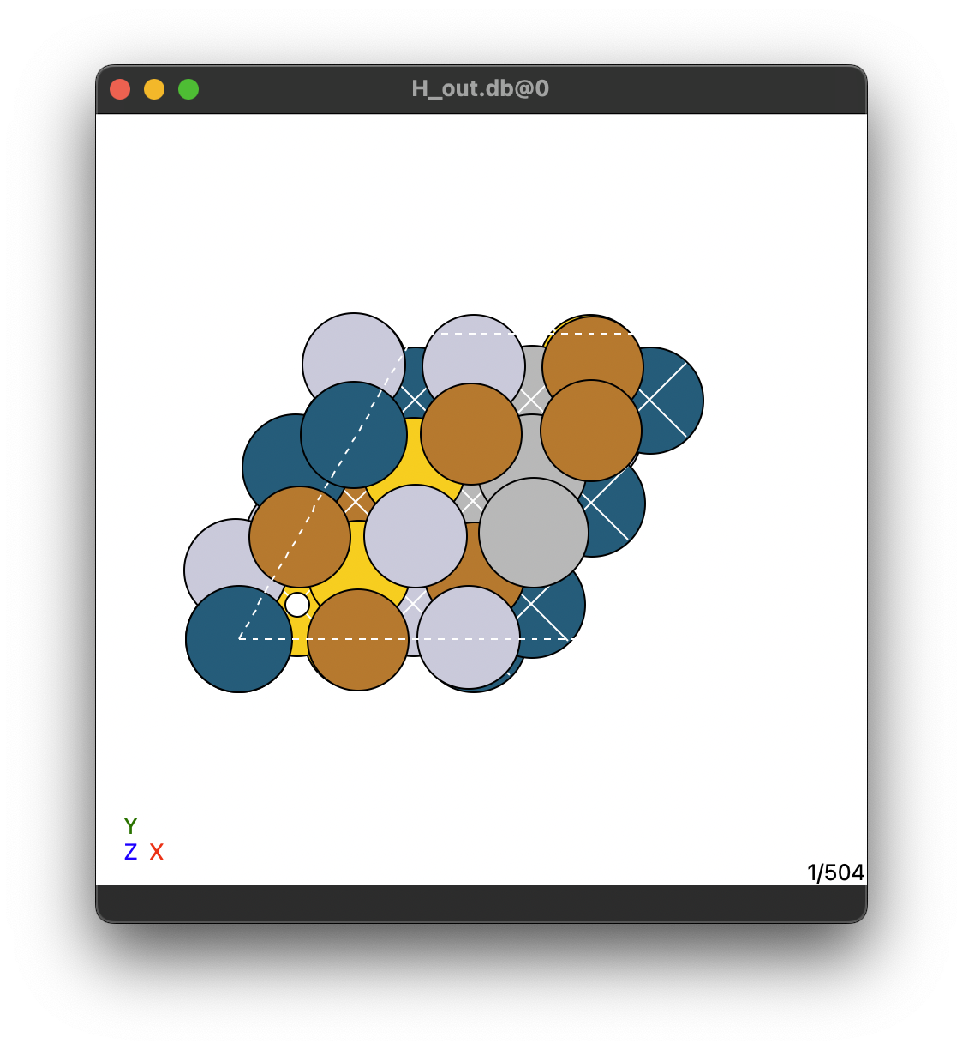
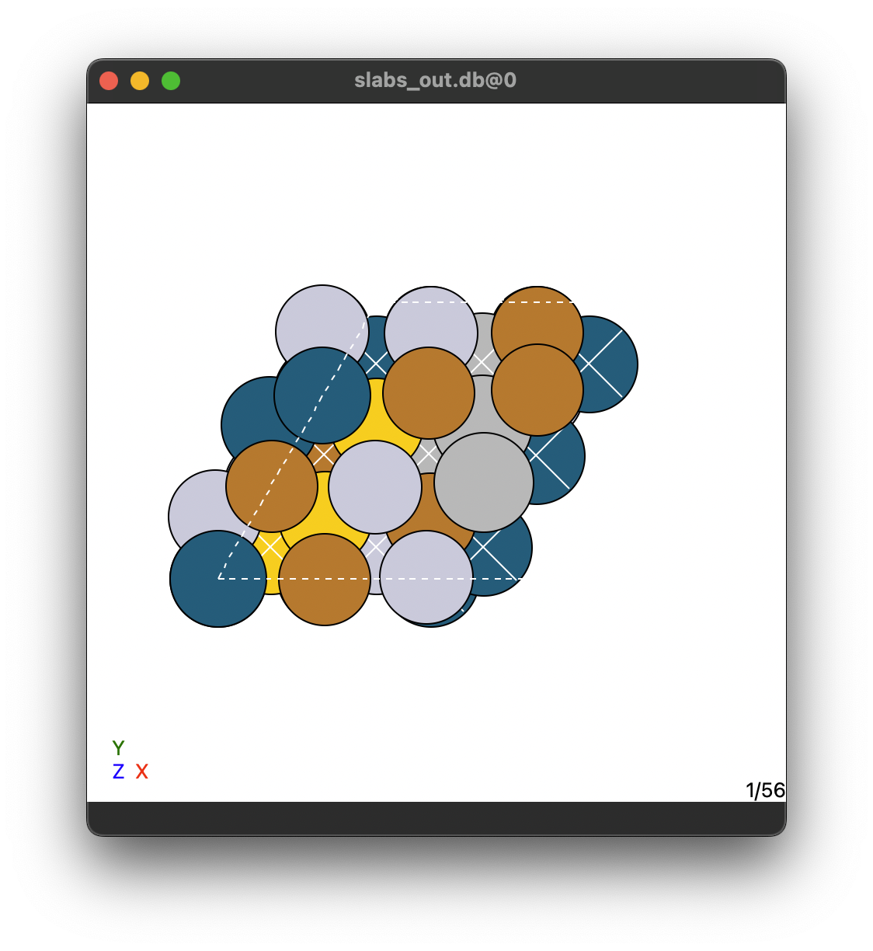
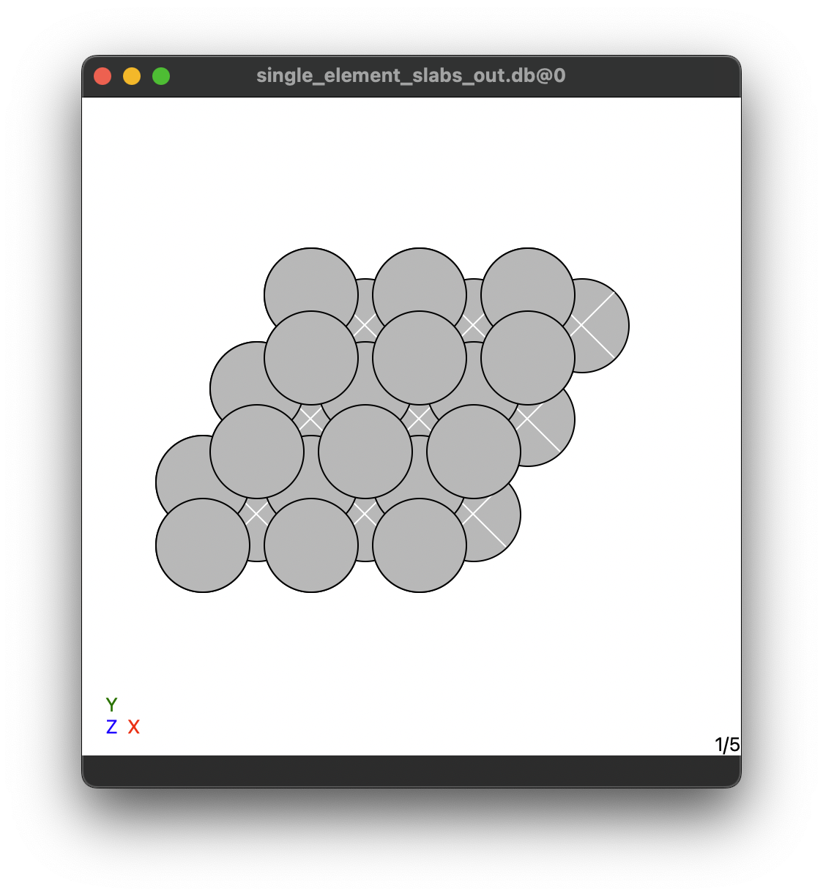
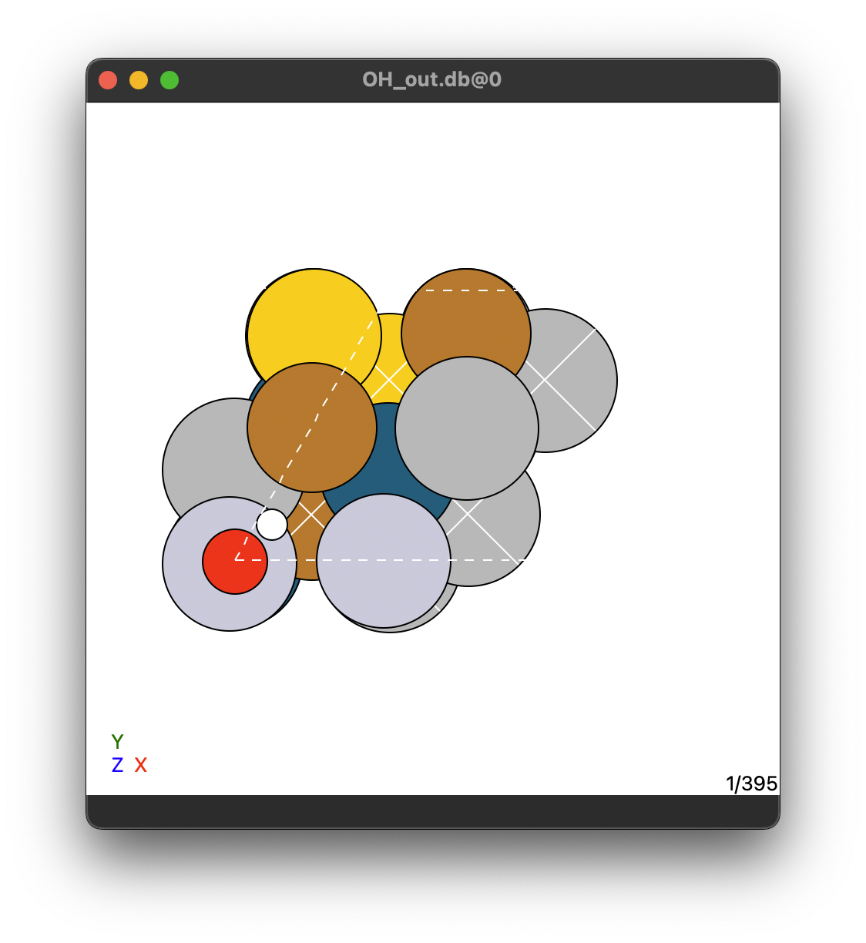
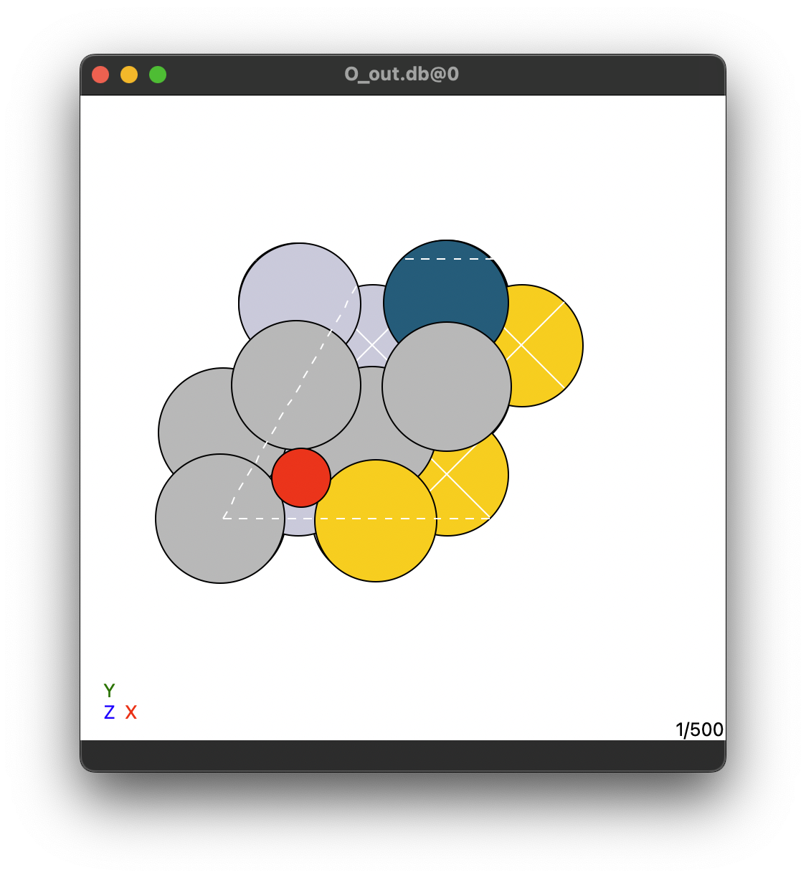
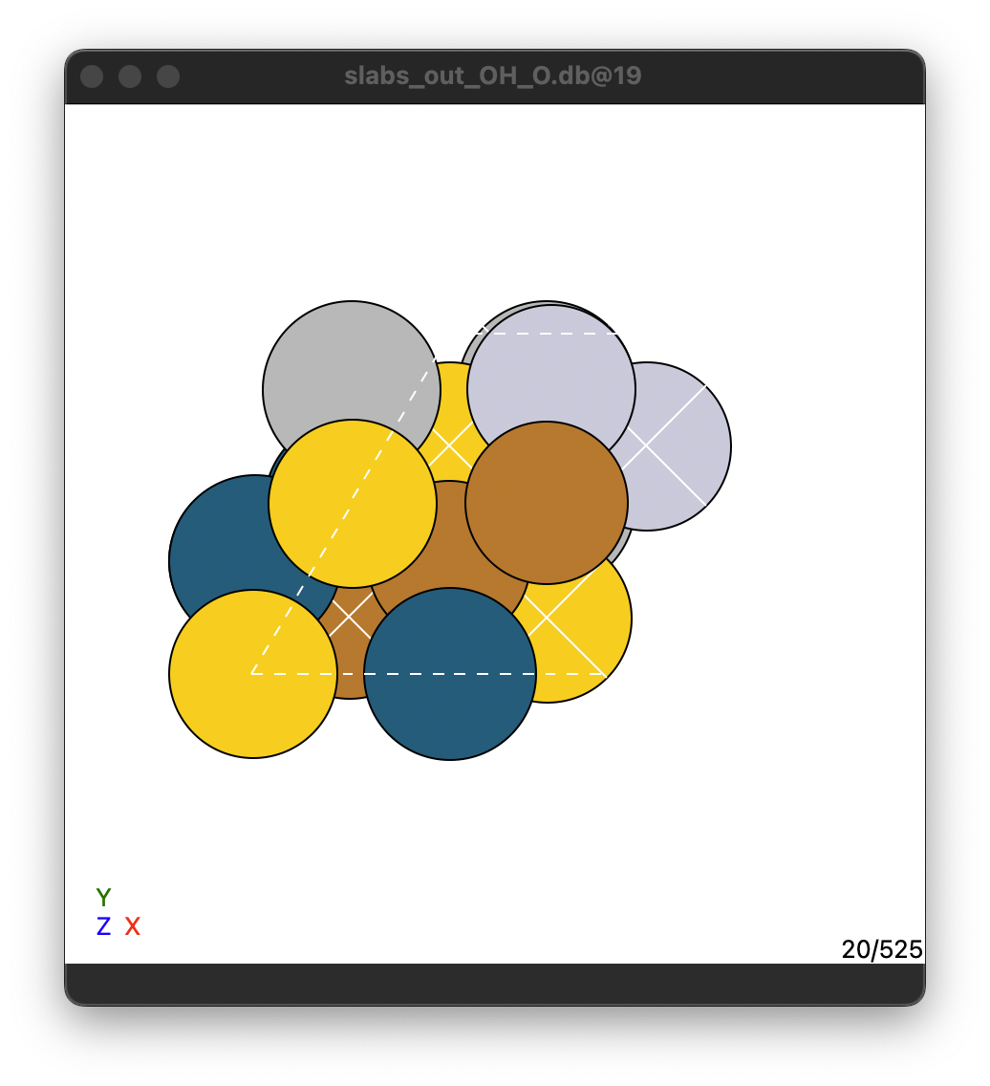
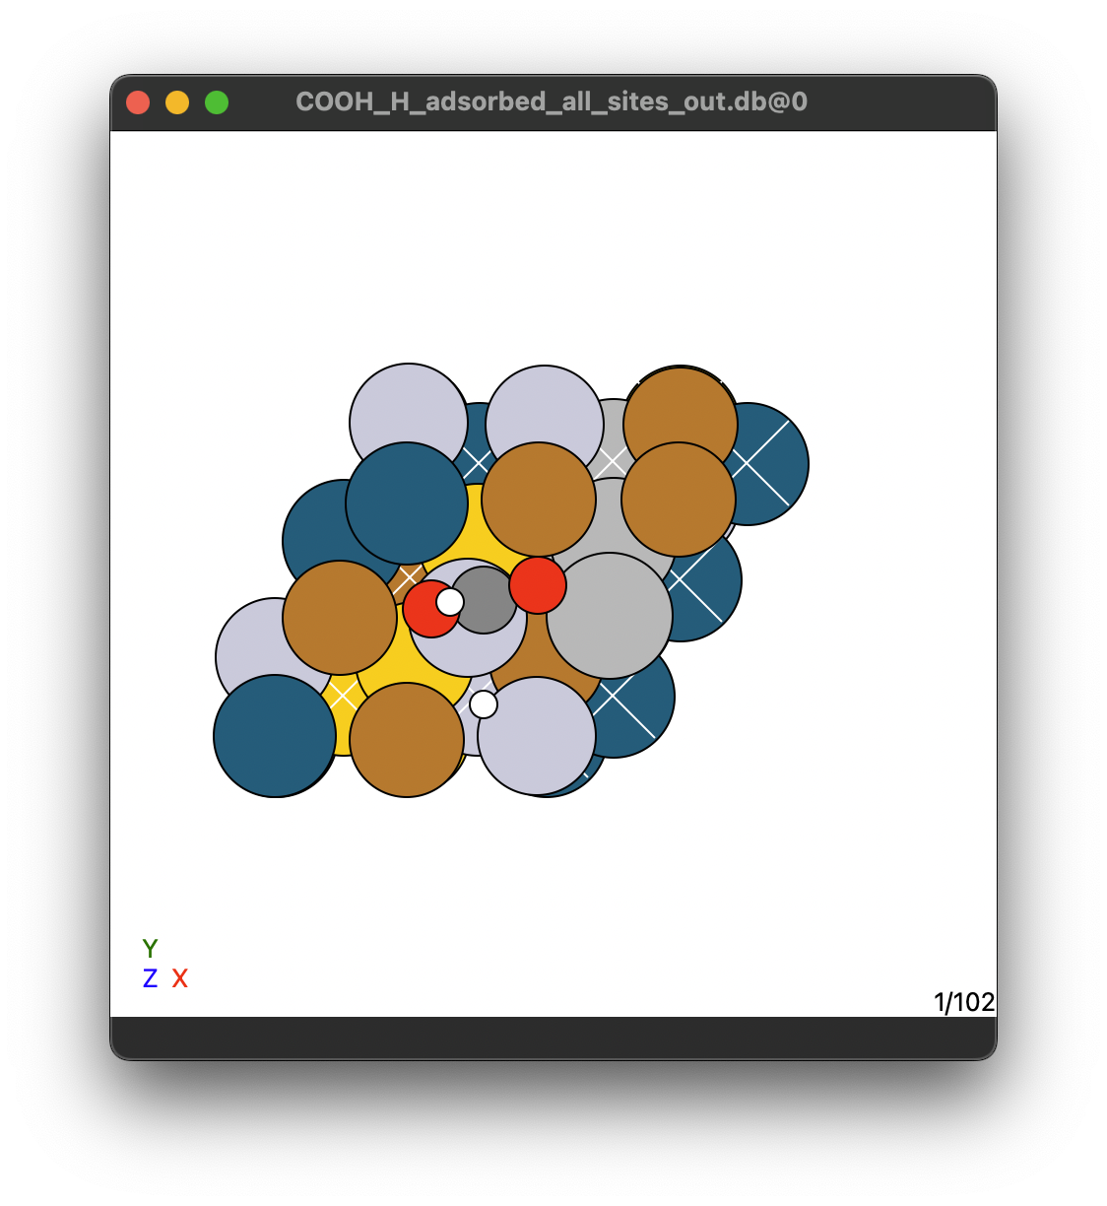
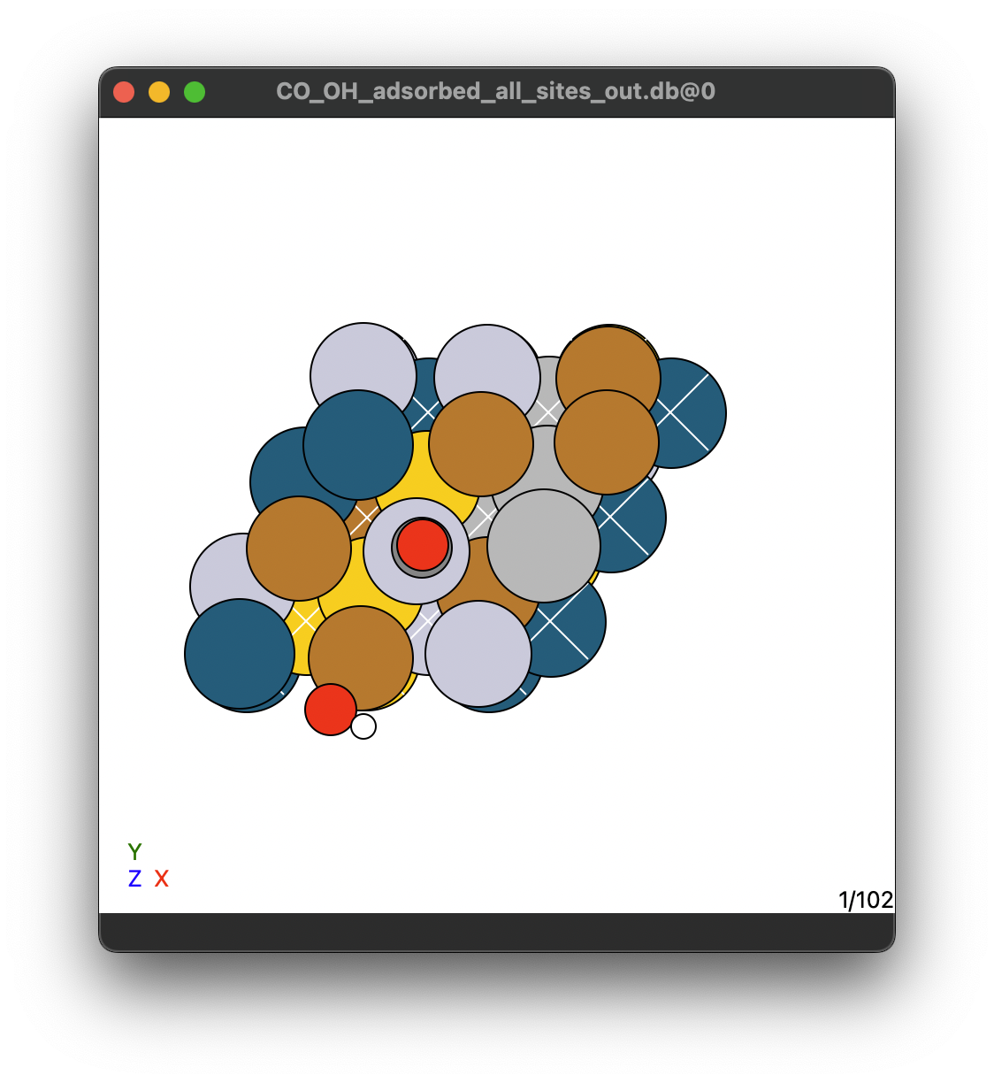
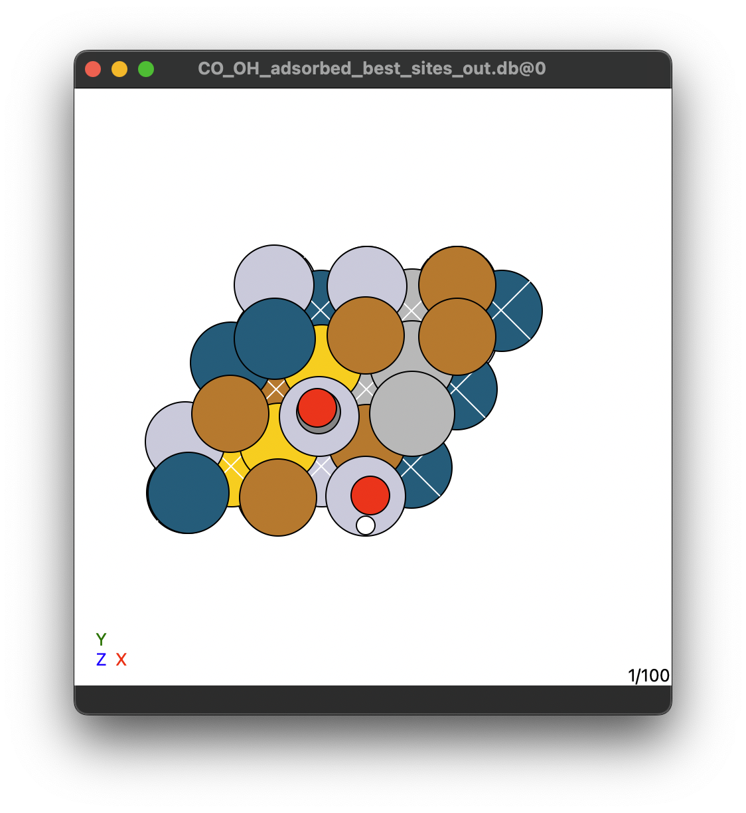

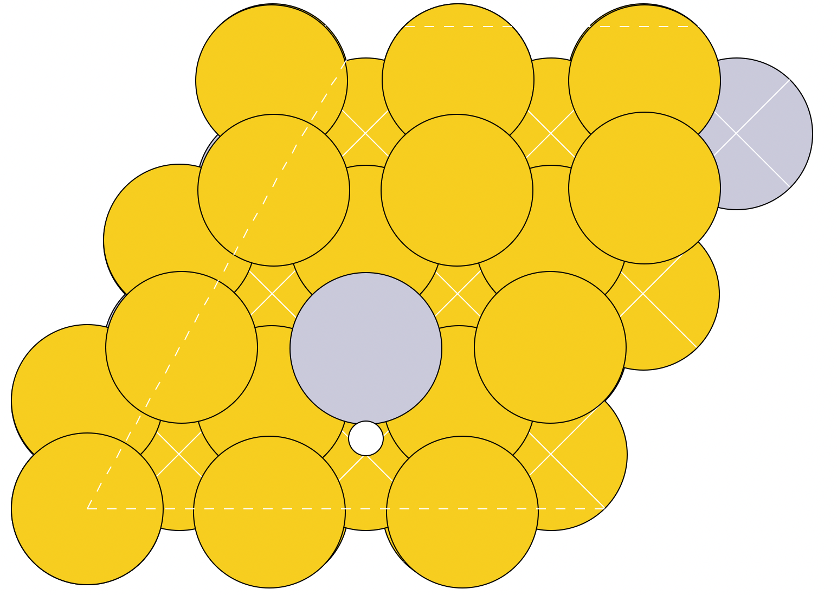
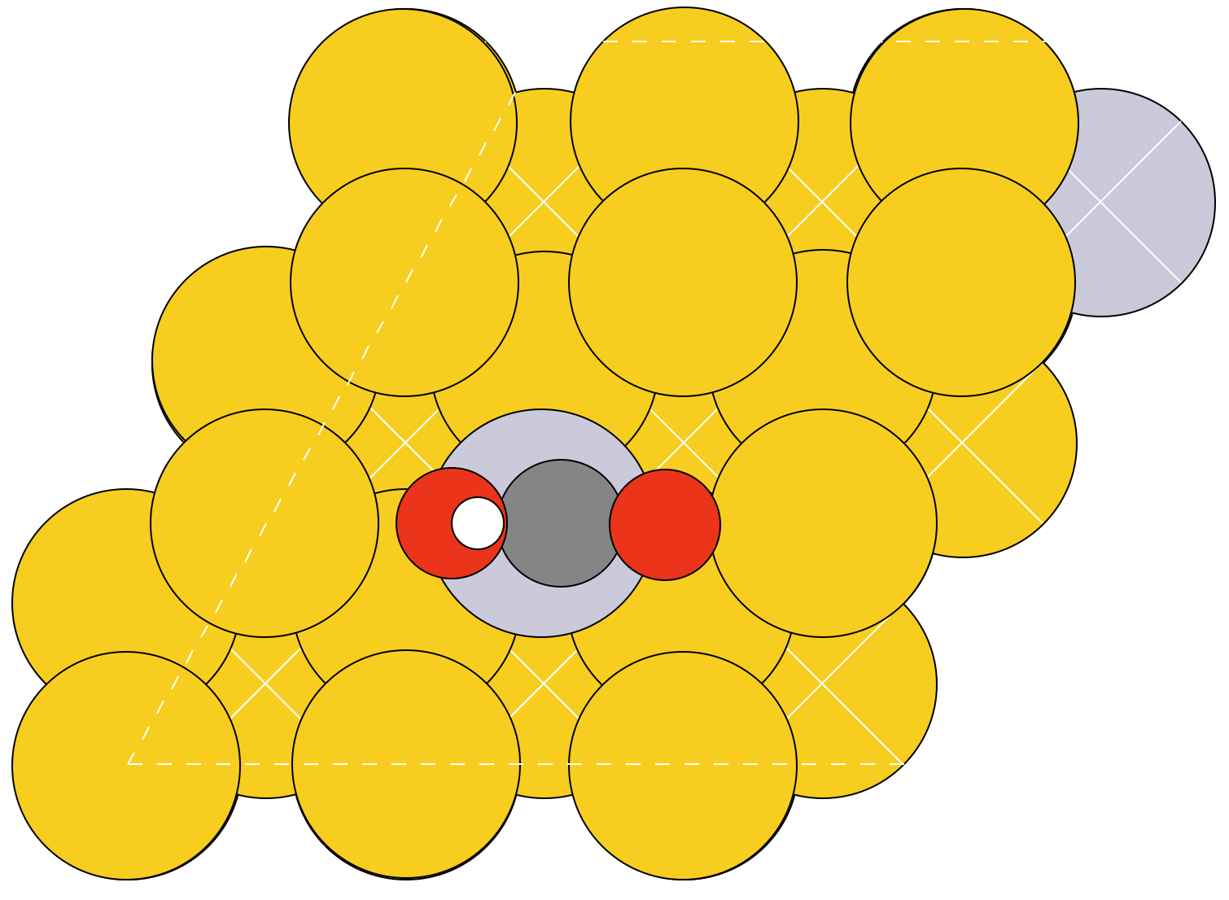
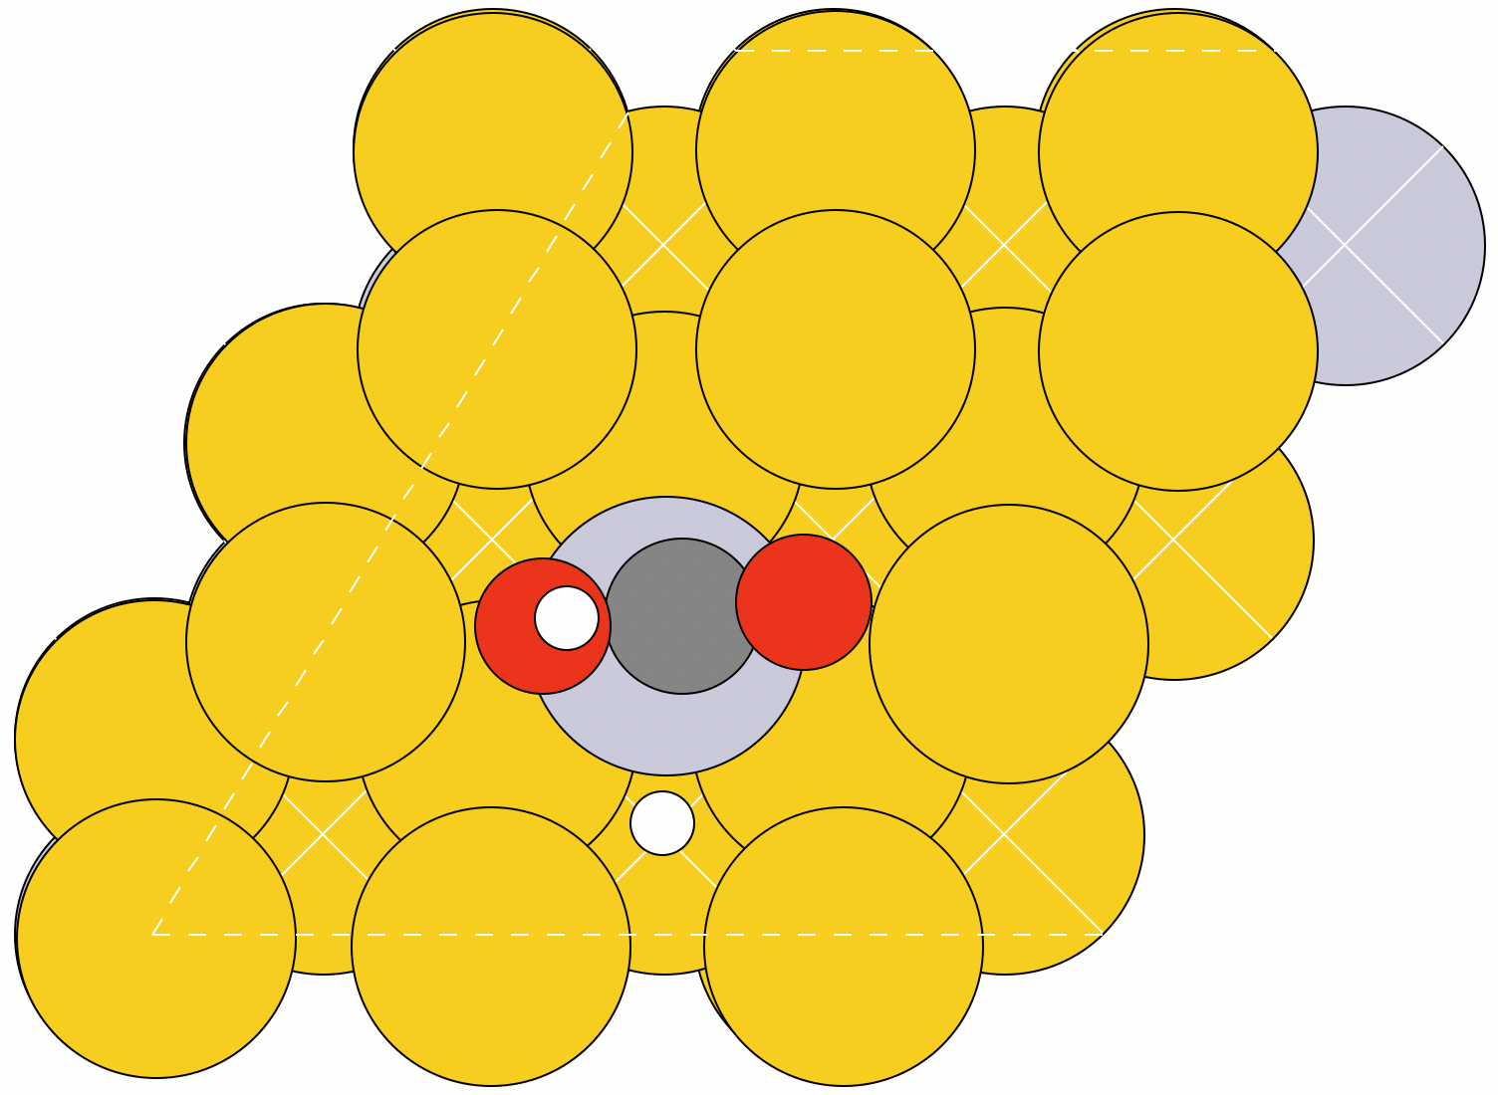
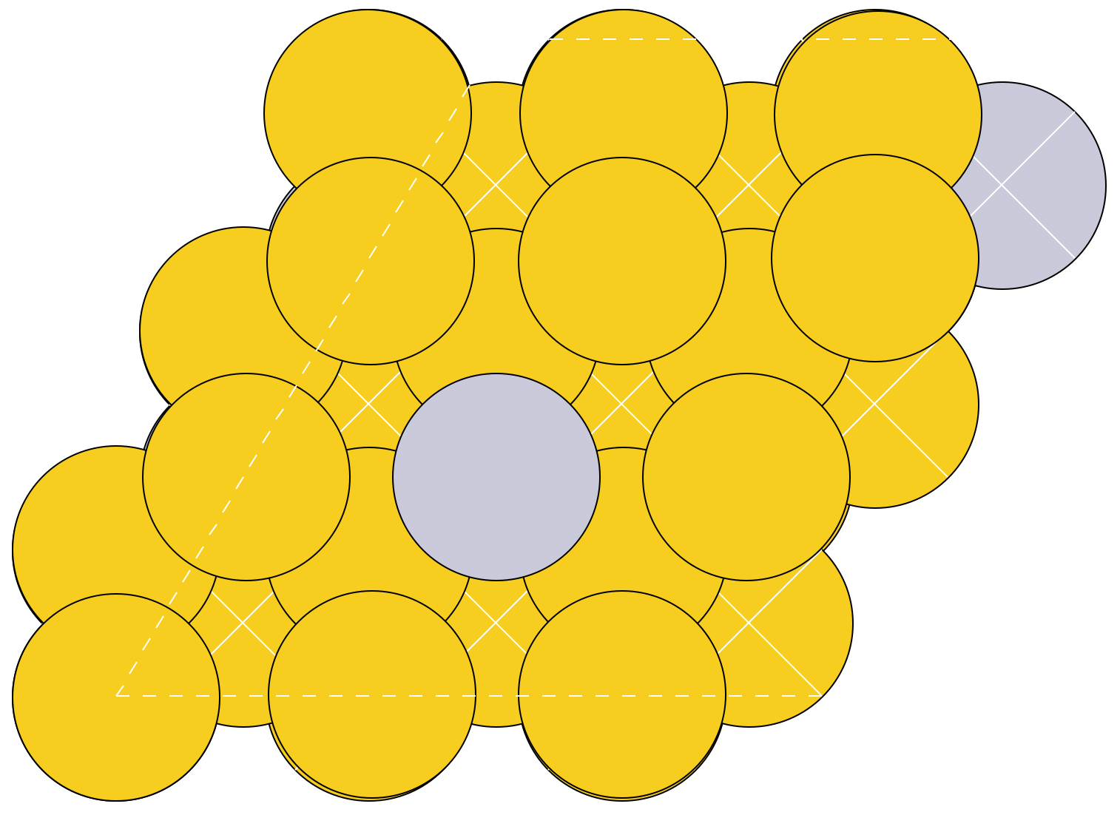
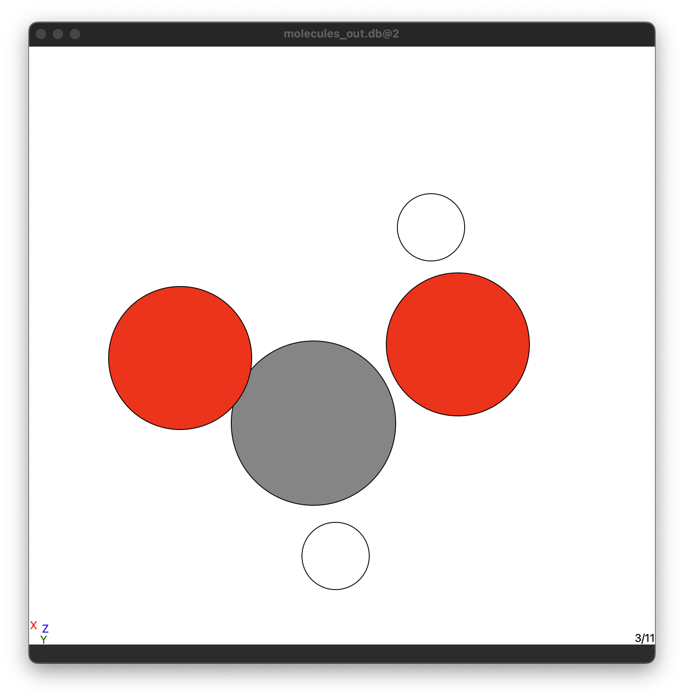
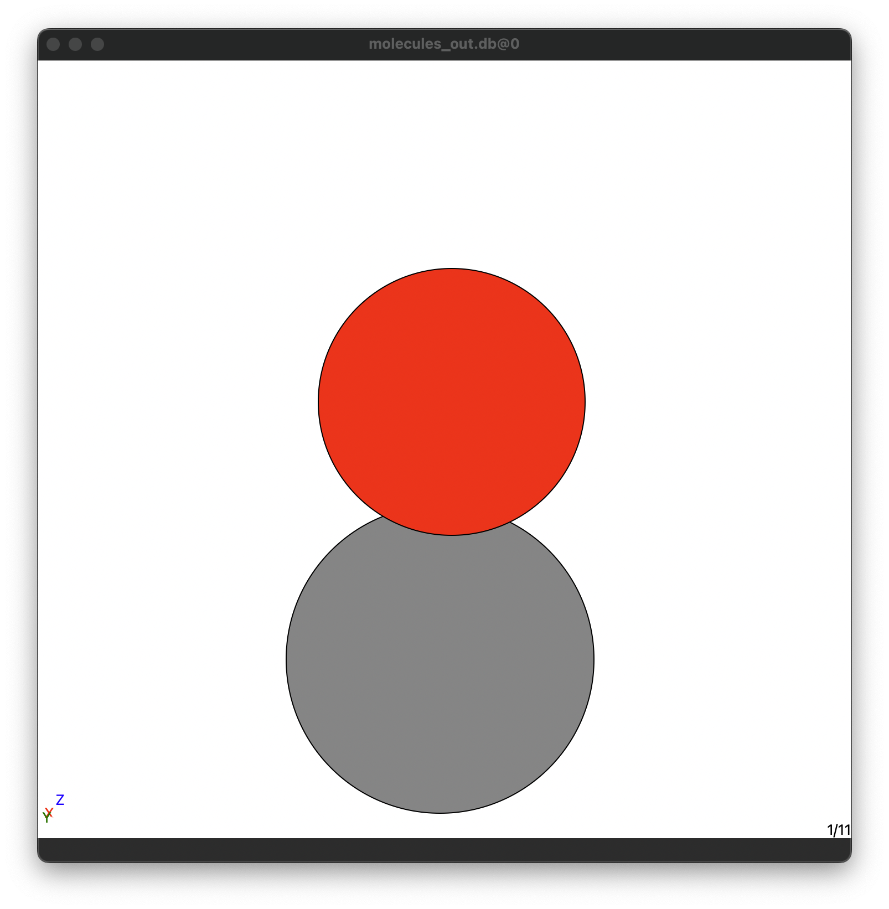

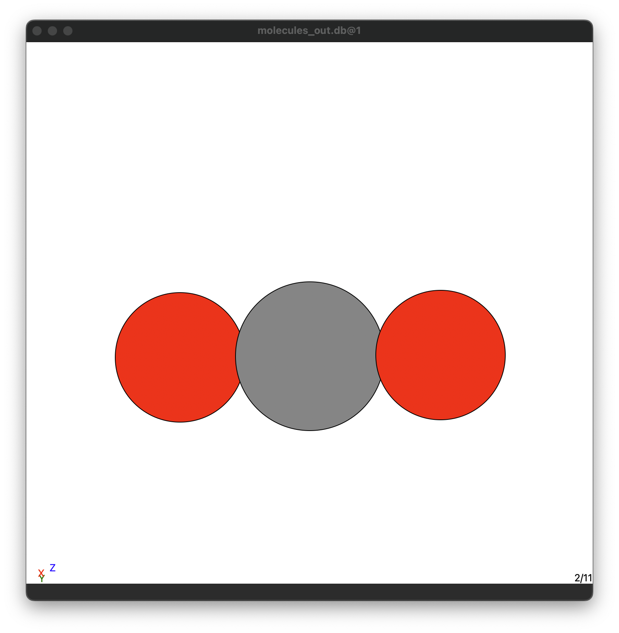
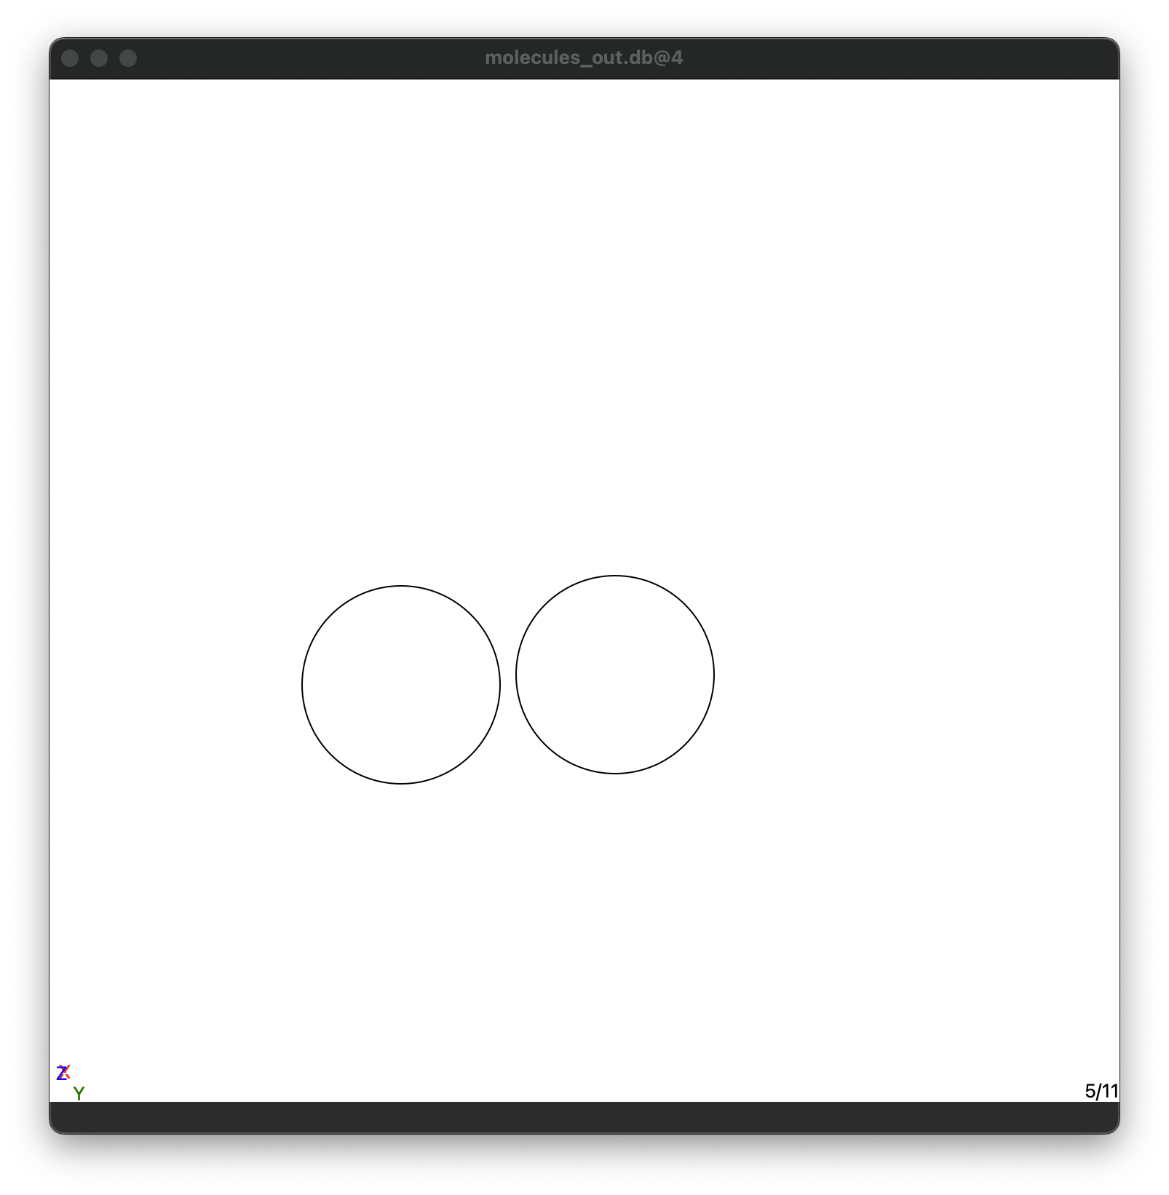
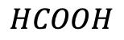
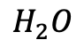
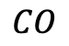
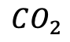
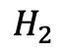
High-Entropy Alloys
Single-adsorbates
On-top
Bridge
On-top
On-top
Hollow-site
56 HEA slabs
5 pure metal slabs
9 sites/slab
56 HEA slabs
0 pure metal slabs
9 sites/slab
56 HEA slabs
5 pure metal slabs
9 sites/slab
56 HEA slabs
5 pure metal slabs
9 sites/slab
56 HEA slabs
5 pure metal slabs
9 sites/slab
56 HEA slabs
On-top
Hollow-site
5 pure metal slabs
395 HEA slabs
5 pure metal slabs
500 HEA slabs
5 pure metal slabs
525 HEA slabs
5 pure metal slabs
High-Entropy Alloys
Neighbouring adsorbates
Hollow-site
On-top
On-top
On-top
On-top
On-top
17 HEA slabs
5 pure metals
6 sites/slab
17 HEA slabs
5 pure metals
6 sites/slab
100 HEA slabs
5 pure metals
1 site/slab
17 HEA slabs
100 HEA slabs
5 pure metal slabs
Single-site structures
Single and neighbouring adsorbates
B
B
Hollow-site
On-top
Hollow-site
On-top
B
A
B
20 slabs/combination
120 total
20 slabs/combination
120 total
20 slabs/combination
120 total
20 slabs/combination
120 total
B
B
Swim ring structure
A: Pt, Pd
B: Ag, Au
Combinations:
PtAu, PtAg, PtAuAg, PdAu, PdAg, PdAuAg
No surface
Single molecules
$$HCOOH$$
$$CO_{2}$$
$$CO$$
$$H_{2}O$$
$$H_{2}$$
1 Calculation
1 Calculation
1 Calculation
1 Calculation
1 Calculation

